Slide 1


Selenium Test Automation – Training 1
Xwing Team

Slide 2

Introduction
This training is planned to give idea on Basic components of Test Automation components, framework and how to run the Automation Test.
Pre-Requisite to Have:-
Visual Studio 2015 or above
Chrome/Firefox/Safari Browsers.
Basic Understanding of any programming Language

Slide 3
Technical Stack
Nunit with hybrid framework
C#
Testing Framework
CSS, ID, name
Language
Automation Framework
Locator Strategy
Selenium WebDriver
Page Object Model
NLog
Test Design Approach
Reporting
Extent Reports
Selenium Grid, Browser Stack
Logging
Parallel Execution

Slide 4
Selenium
Selenium is a free (open-source) automated testing framework used to validate web applications across different browsers and platforms
Major Components:-
Selenium IDE (Just an record and Playback tool)
Selenium RC (Deprecated)
Selenium WebDriver (We have used this in our framework)
Selenium Grid (For parallel Execution)

Slide 5
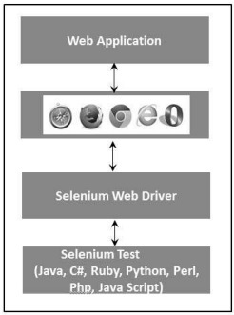
Selenium WebDriver
Selenium WebDriver acts as a Bridge between our Programming scripts and Web-browsers.
It converts our code into browser understandable format.

Slide 6
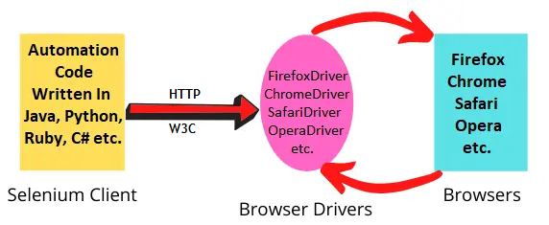
Selenium WebDriver
Selenium Client Libraries:- The Selenium Client Library or the language bindings component of the Selenium WebDriver architecture allows us to write the Selenium automation scripts in the language of our choice – Java, Python, C#, Ruby, JavaScript, etc.
Browser Drivers:- For each of the supported browsers in Selenium, we have a separate browser driver. These drivers take command from the selenium scripts and pass them to the respective browsers in order to automate the web application.
JSON Wire Protocol over HTTP:- In the WebDriver architecture, the JSON wire protocol is used for communication between the selenium scripts and the Browser Drivers.
Browsers:- This component of the Webdriver architecture in Selenium is pretty straightforward. The browsers receive the command and call the respective method to perform the desired automation task.
Driver.get(https://www.google.com)
http://localhost:7705/ { "url": "http://www.google.com" }
Chrome Driver

Slide 7
Locator Strategy
This is helpful in locating the elements (Textbox, Dropdown, Buttons, links) in webpage.
There are many locating strategies and we use CSS, name and ID in our framework

Slide 8
Understanding DOM in Webpage
Input -------------------------→ Tag Name
Auto capitalize
Autocomplete
Autocorrect
Class
Data-val
Data-val-required -----------------→ Attributes
Id
Name
Spellcheck
Type
value
Tag represent the type of Object. For example, Input represent Text box. Common tags and their object representations
* a → Link
* Select → Dropdown
* button → Button
For more details visit https://www.tutorialspoint.com/html/html_tags_reference.htm
Attributes corresponds to properties of tag.

Slide 9
CSS selectors
Syntax:- <HTML tag><attribute><Value of ID attribute>
CSS Value -- > Input[id=‘UserID’]
CSS Value → a[id=‘submitButton’]
CSS Value → a[aria_label='Click here to find your user ID?']

Slide 10
Nunit
Nunit is Unit testing framework which is widely used for Automation Testing.
It only provides some custom attributes and some static Assert classes. With the combination of custom attributes and static classes, we can write unit test cases easily.
Common Attributes:-
TestFixture
Setup
TearDown
Test
Category
Description

Slide 11
Page Object Model
For every page in web application, we create separate .cs file. All web Elements and methods of that web element will be present in the class file.
This approach will help us to maintain the code and let us know where exactly we need to modify if there is any changes in the application.

Slide 12
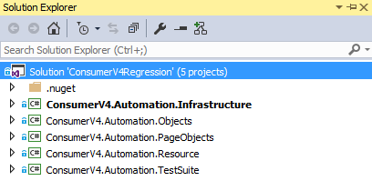
Framework Architecture Specific to Consumer, Business and Portal
Infrastructure - Contains Application Independent Components.
Objects - Contains Data Property.
Page Objects - Isolated Storage of application specific Web Elements, and Module specific Workflows
Resources - Contains reusable functions to handle database checks, page connection factories
Test Suite - Contains logical grouping of test cases constituting Test Scripts (includes data creation and Test Script)

Slide 13
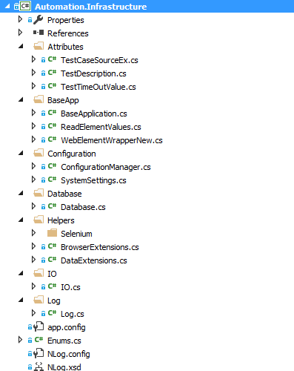
Infrastructure Component
Attributes:- Testcases Source, TestTimeoutValue, Test description are customized Nunit attributes to provide more future.
BaseApp:- Create Instance for Logger and Webdriver based on details in config file
Configuration:- To read the value from APP.config file
Database:- Contains components to establish DB connectivity for SQL server, and Other DML operations
IO:- Contains components to establish connection to the excel to read the data using OLEDB connectivity
Log:- Contains utility component to generate Extent Report in Html
Nlog to trace the test error, based on the warning level

Slide 14
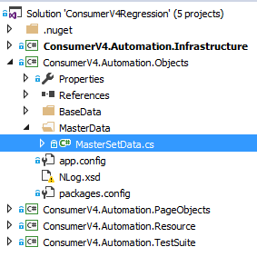
Object Component
This project contains data property, it stores test level data. Using Test case Source Attributes, data will be fetched from excel and stores data as property which will be used in the respective test method.

Slide 15
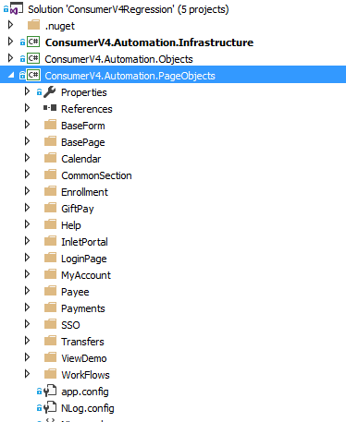
Page Object Component
This project is used to store all the web elements used for interaction with the application. A class file will be created for each page, and it will be having the reusable components or the action oriented components.
In order to make the assertion in customizable way, check points have been added to make specific - Page loaded (check for URL), Root element of the page (locator) available, and then proceed with the action oriented components.
Pages have been grouped based on the feature available, and specific XMl file is mapped to add the locator to enhance the readability and maintainability.
Page Object also contains workflows, which is collection of user action oriented components, to be reused in the actual test.

Slide 16
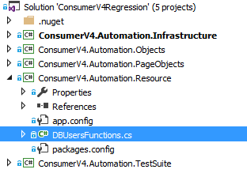
Resource Component
This project contains reusable components that will interact with the data base like fetching User, or Permission or Report related details.

Slide 17
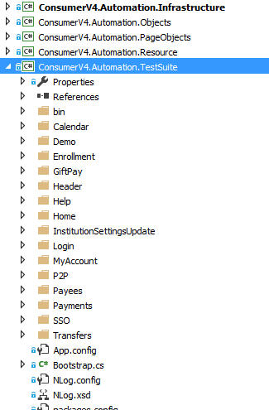
Test Suite Component
This project contains actual test methods and here where we will interact with other sub projects.
Test Fixture has been grouped based on the features available in the application like Login, Payees, Payments and Transfers

Slide 18
Run Automation Cases
Checklist before running any Automation Scripts:-
We have do make some settings in App.config file present under Test Suite Project.
Chrome Location - > Install Chrome Driver from here (Place it in your system)
Search for “ChromeDriverLocation” key in app.config file. Update the value with path where you stored the Chrome driver.
Appending String - > b1 – Smoke and b2 – Regression
UpdateResultsInMTM -> True

